Slide 1
GSEA analyses for NtcA on repressed genes
John Aach
May 15, 2006

Slide 2
Methods
The Su et.al. (2005) supplementary material contains the sequence downstream of the NtcA box and also the −10 box itself (where found). From this it was possible to find the distance into this downstream sequence of the start of the −10 box. There were also genes listed that had NtcA sites without -10 boxes. Note that due to construction of the Su et.al. data sets, −10 boxes upstream of NtcA sites are not considered.
GSEA tests were performed on lists of genes, some of which are described below, considering only the 6 and 48 hour time points in MED4 and MIT9313, using the Direction parameter of gsea.m to look for enrichment among repressed genes.
  Negative control: For the 6 hour time point, a GSEA test was run with the top 15 ranked NtcA sites for genes with both orthologs and non-orthologs ranked separately (see Methods in manuscript). These are parameters equivalent to those run for 6 hour enrichment of induced genes, except that the direction of the test was reversed so as to look for enrichment among repressed genes. This test is a negative control because the fact that these genes were enriched among activated genes means that they should not also have been enriched among repressed genes. Remaining tests considered sets of genes with NtcA sites without −10 boxes or with NtcA sites close to −10 boxes which might be occluded by NtcA binding.

Slide 3
Methods (continued)
  A list was prepared of genes with that were identified in Su et.al. (2005) as having NtcA sites without downstream −10 boxes. These could be sites that block transcription initiated by upstream binding sites for the RNA polymerase and associated factors. The situation is diagrammed below. GSEA tests looking for enrichment among repressed genes were conducted using this list and considering the top 15 sites for genes listed as having orthologs and as not having orthologs, ranked separately.
X
gene
RNAP
NtcA
  A list was prepared of genes with that were identified in Su et.al. (2005) as having NtcA sites that were within 15bp of a downstream −10 box. These could be sites that are so close to the −10 box that NtcA binding occludes it, thereby blocking transcription. The situation is diagrammed below. There are only a very small number of these sites, and all were used in the GSEA regardless of NtcA site rank: MED4 has 16 (9 for genes with and 7 for genes without orthologs) and MIT9313 has 8 (6 for genes with and 2 for genes without orthologs).
X
RNAP
gene
NtcA
-10 box

Slide 4
Results
All tests were negative for enrichment (P>>.05). The smallest P value was .6544 (MIT9313 time point 48 hr for NtcA sites within 15bp of a −10 box).

Slide 5
MED4 GSEA tests for NtcA site enrichment among repressed genes

Slide 6
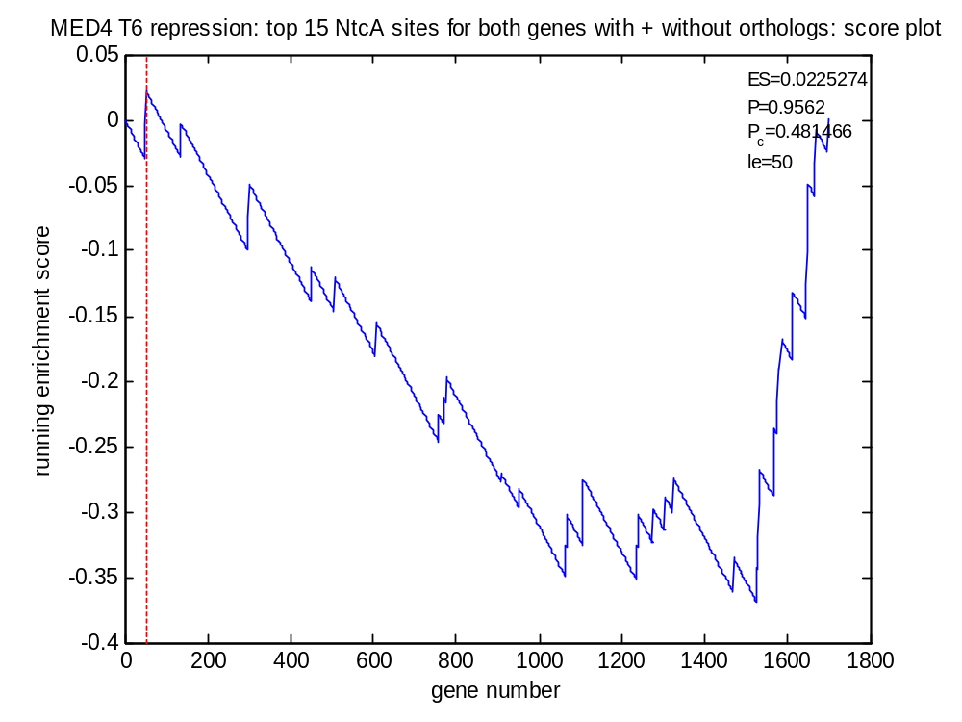
Negative control

Slide 7
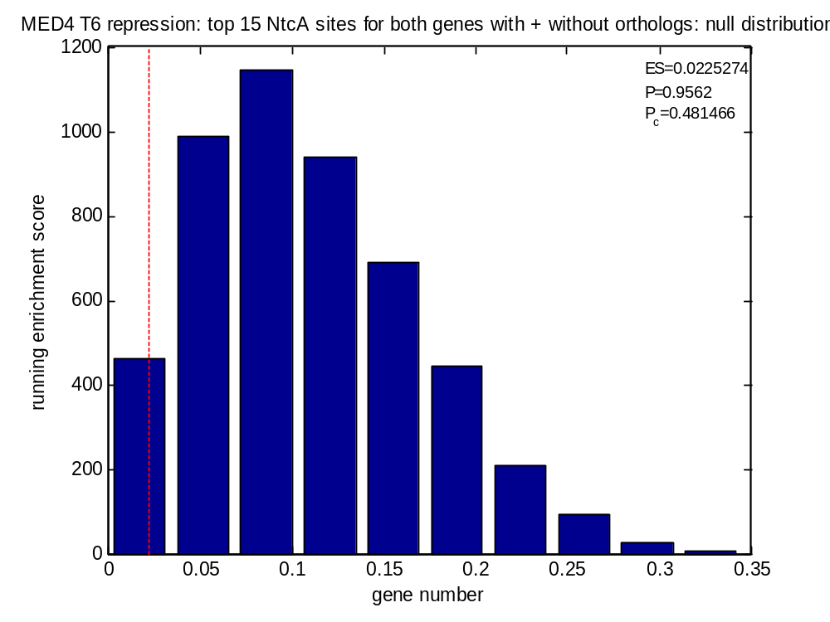
Negative control

Slide 8
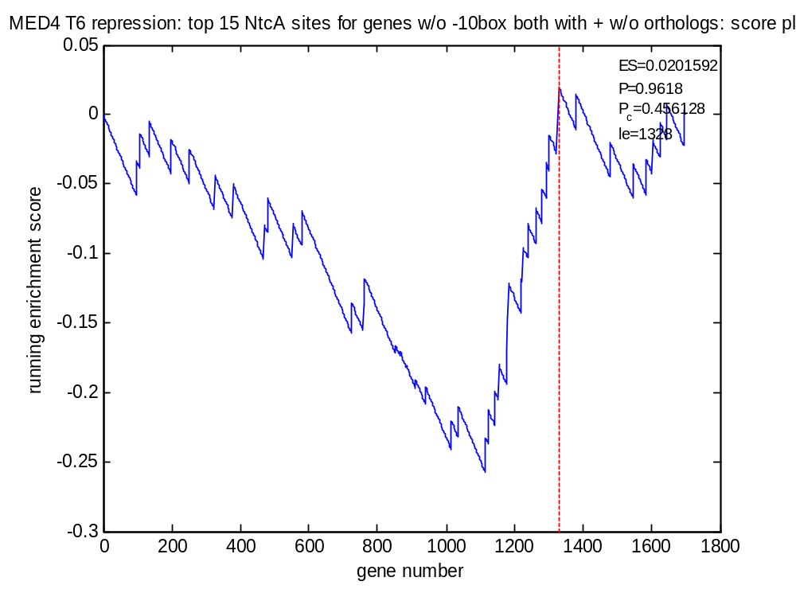
X
No -10 box
Time = 6hr
gene
RNAP
NtcA

Slide 9
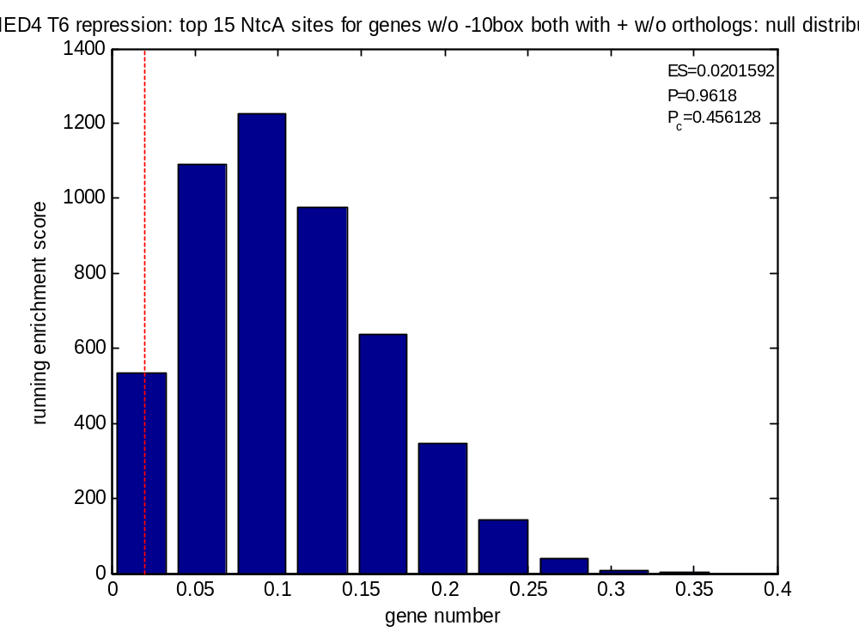
X
No -10 box
Time = 6hr
gene
RNAP
NtcA

Slide 10
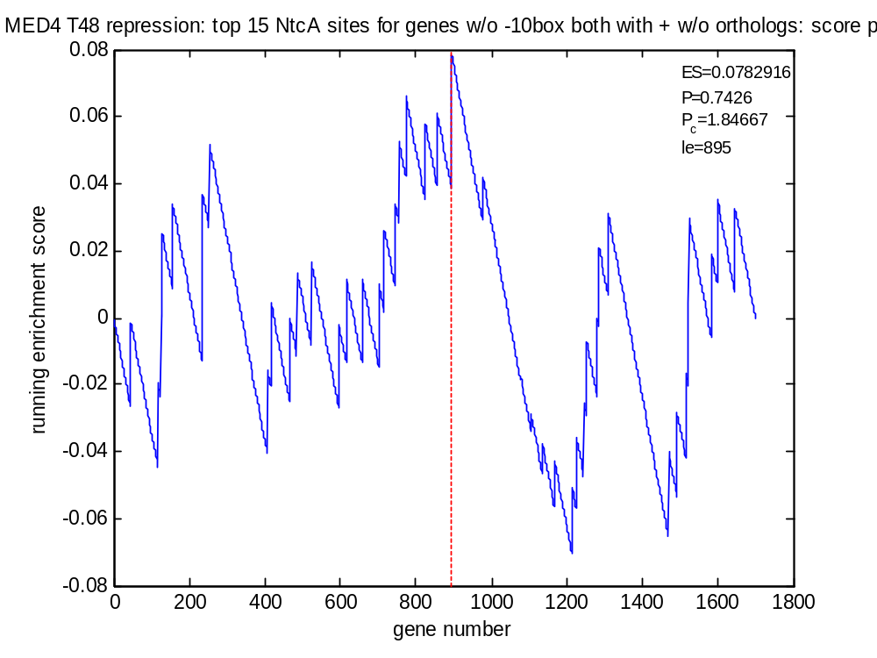
X
No -10 box
Time = 48hr
gene
RNAP
NtcA

Slide 11
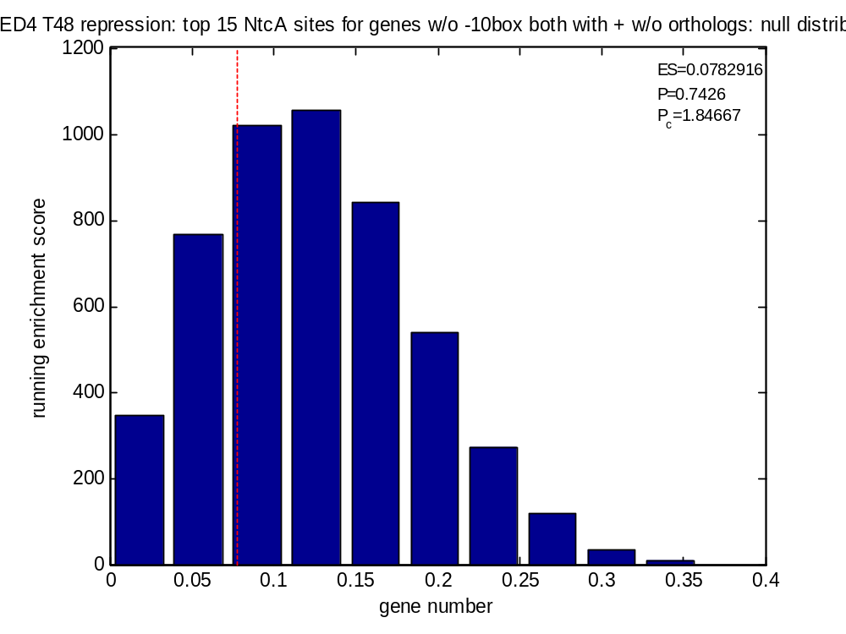
X
No -10 box
Time = 48hr
gene
RNAP
NtcA

Slide 12
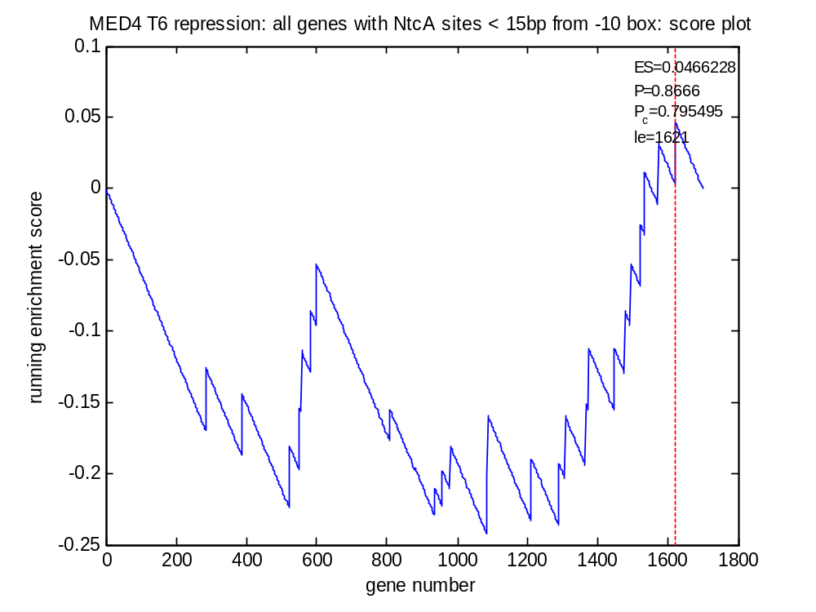
X
RNAP
gene
-10 occluded
Time = 6h
NtcA
-10 box

Slide 13
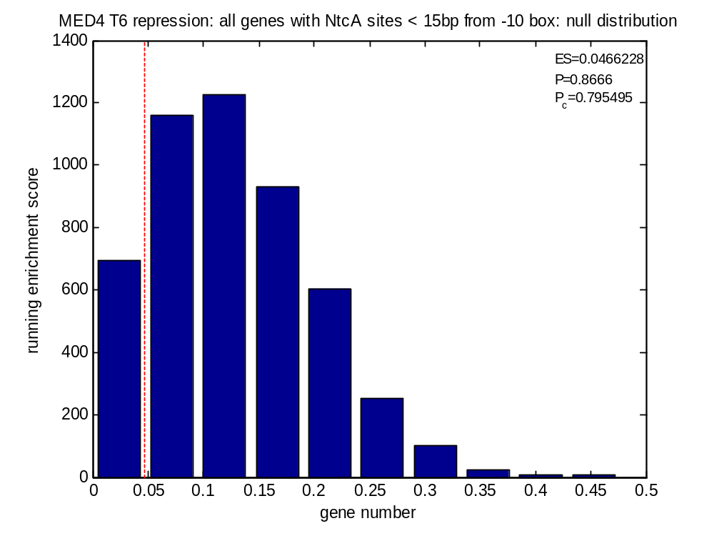
X
RNAP
gene
-10 occluded
Time = 6h
NtcA
-10 box

Slide 14
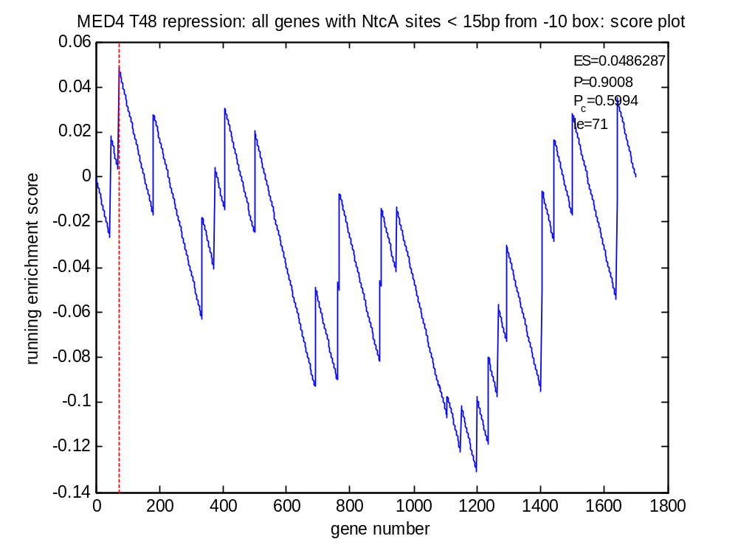
X
RNAP
gene
-10 occluded
Time = 48h
NtcA
-10 box

Slide 15
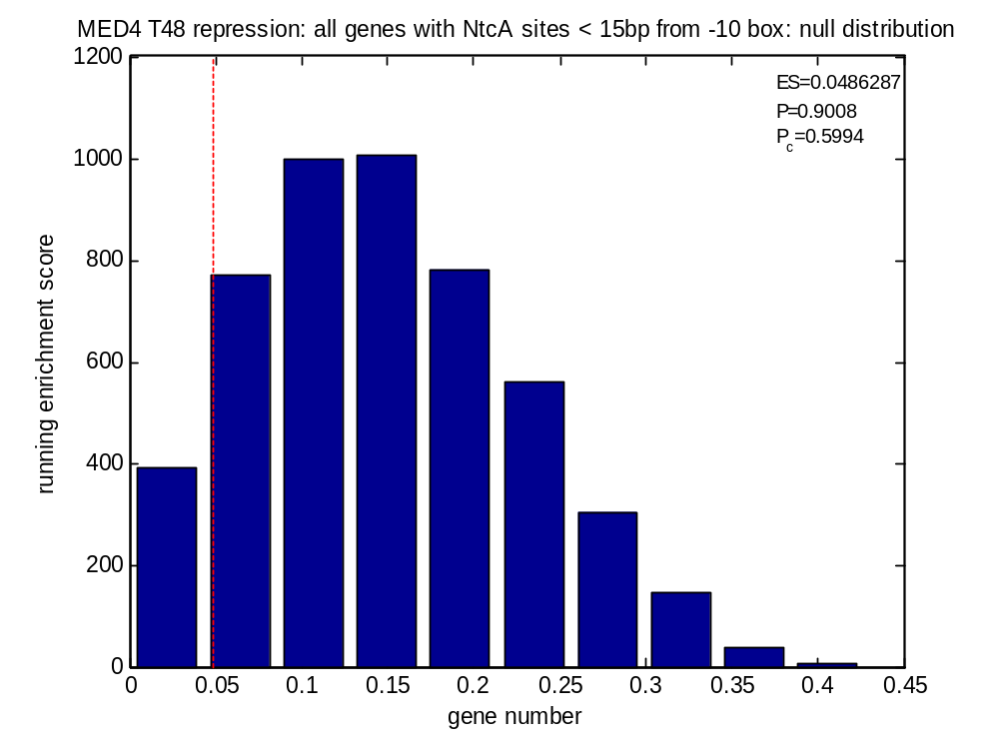
X
RNAP
gene
-10 occluded
Time = 48h
NtcA
-10 box

Slide 16
MIT9313 GSEA tests for NtcA site enrichment among repressed genes

Slide 17
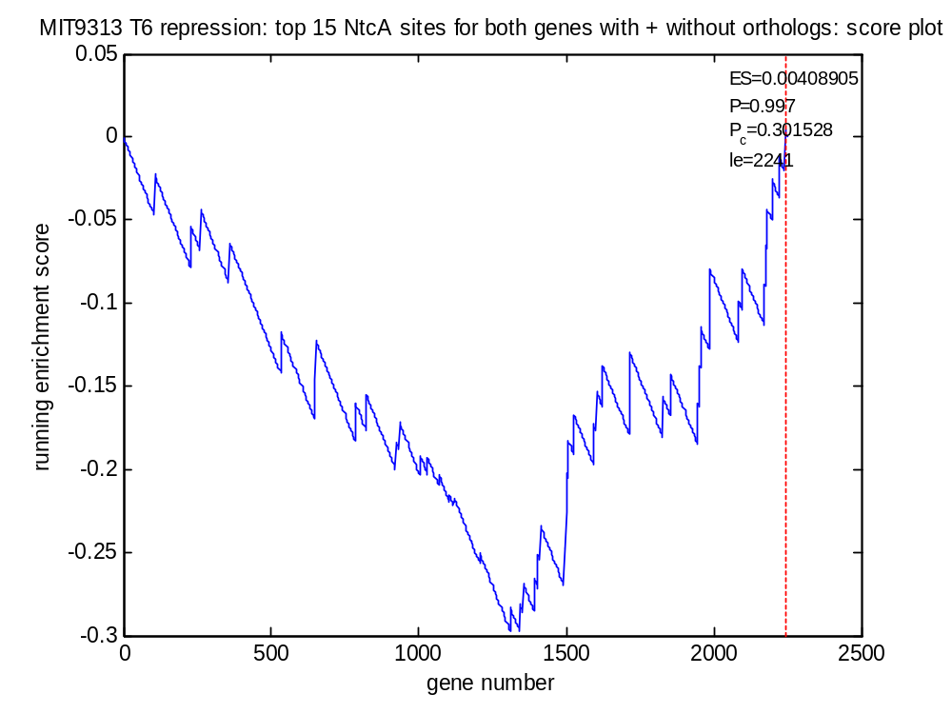
Negative control

Slide 18
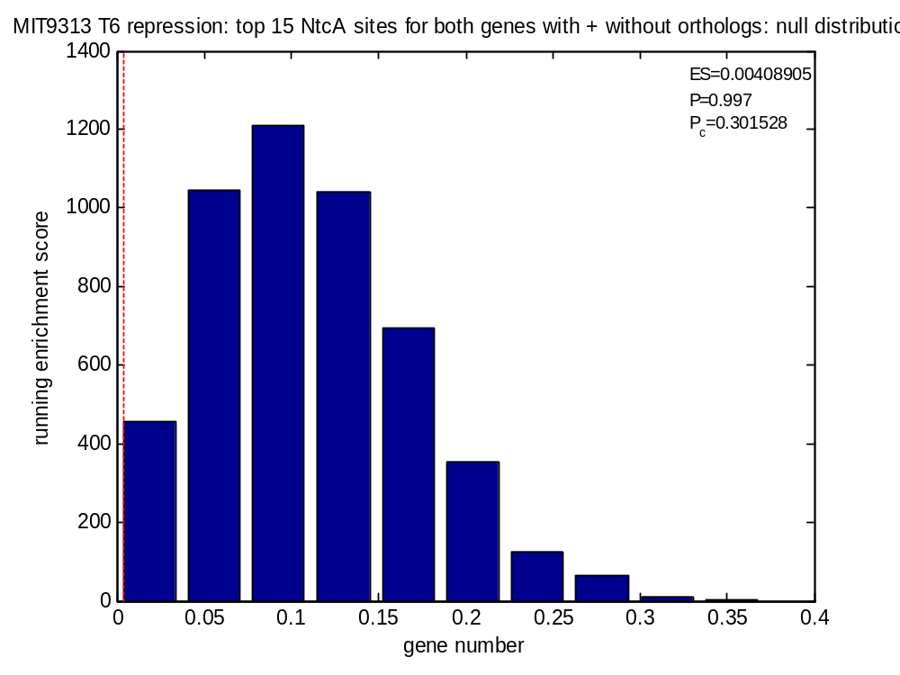
Negative control

Slide 19
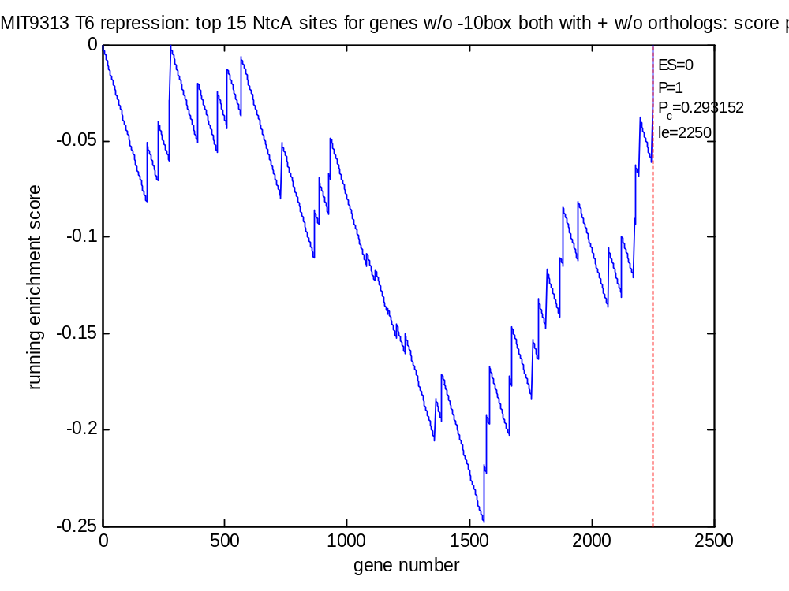
X
No -10 box
Time = 6hr
gene
RNAP
NtcA

Slide 20
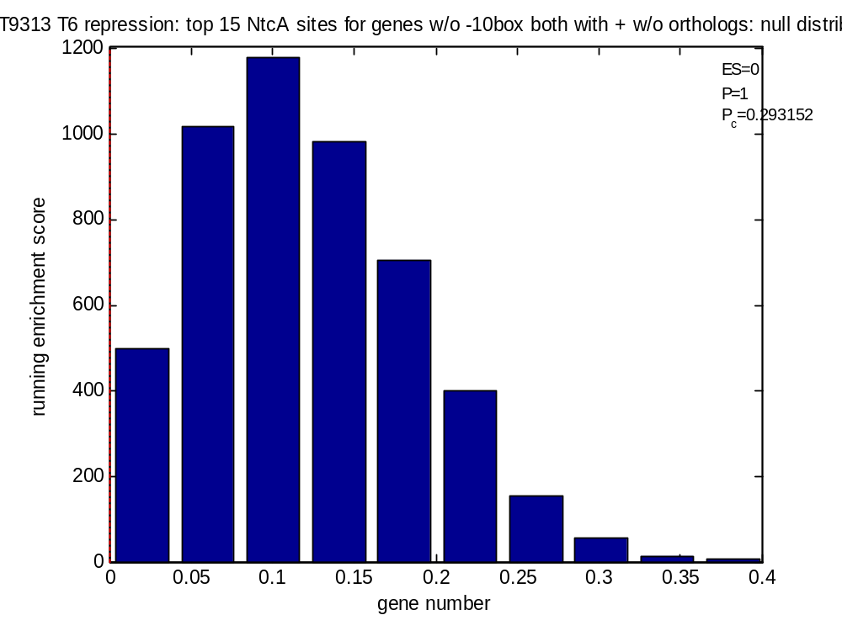
X
No -10 box
Time = 6hr
gene
RNAP
NtcA

Slide 21
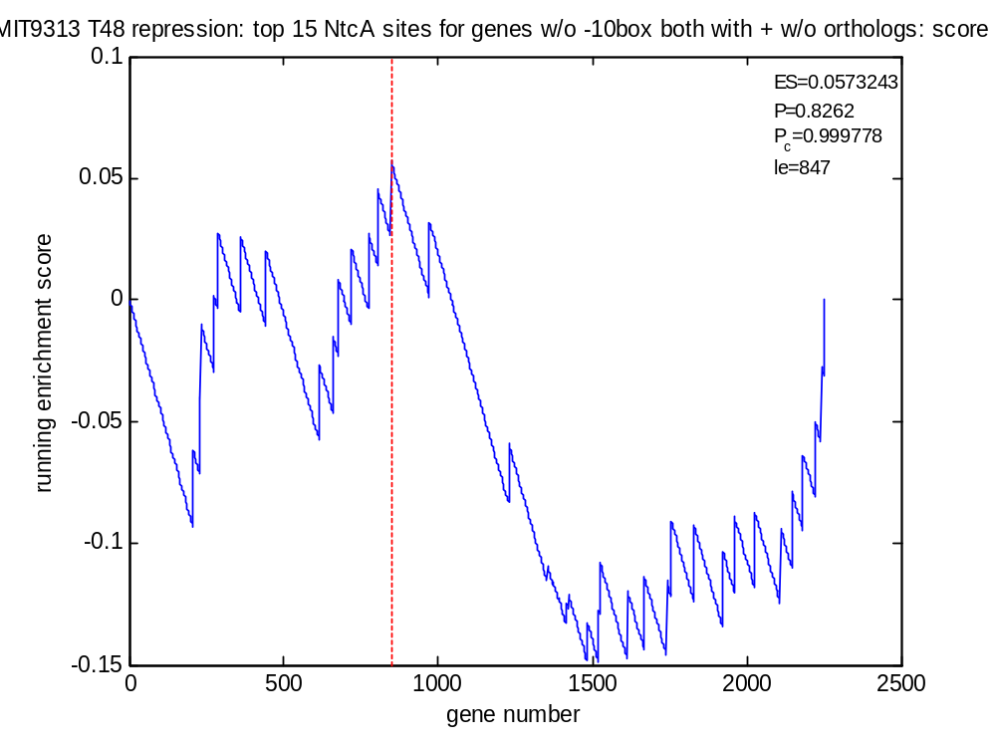
X
No -10 box
Time = 48hr
gene
RNAP
NtcA

Slide 22
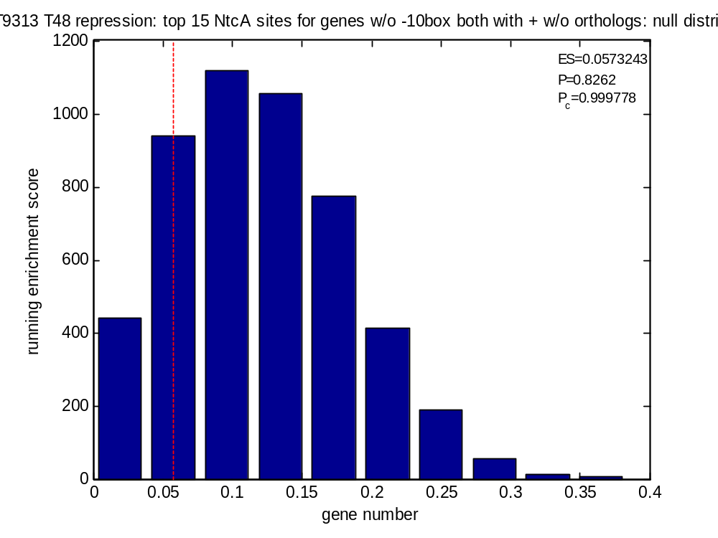
X
No -10 box
Time = 48hr
gene
RNAP
NtcA

Slide 23
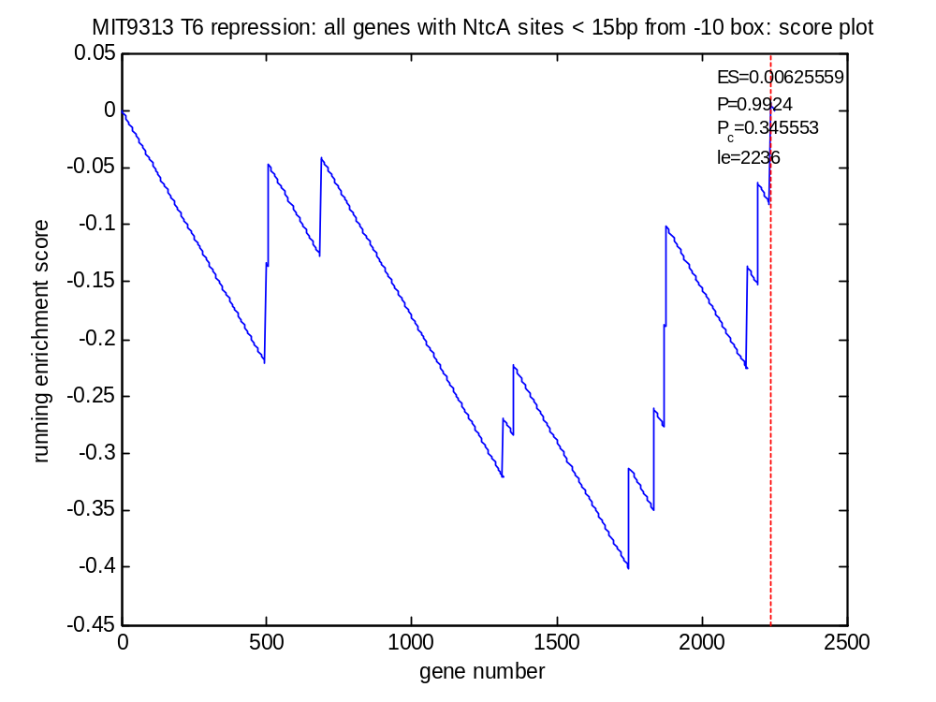
X
RNAP
gene
-10 occluded
Time = 6h
NtcA
-10 box

Slide 24
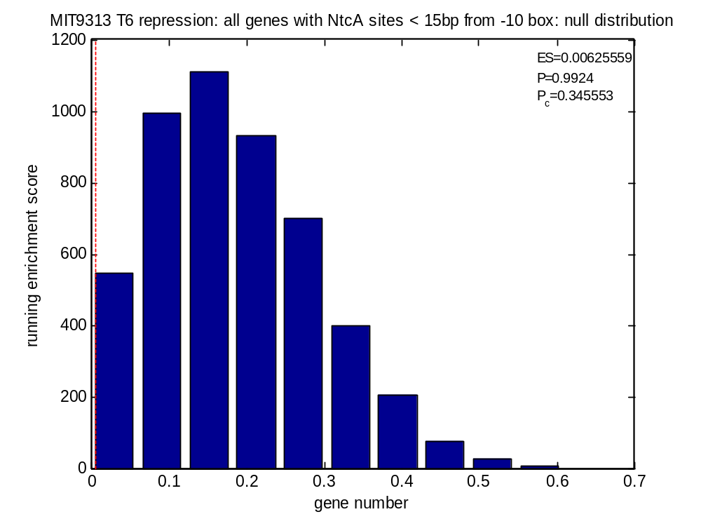
X
RNAP
gene
-10 occluded
Time = 6h
NtcA
-10 box

Slide 25
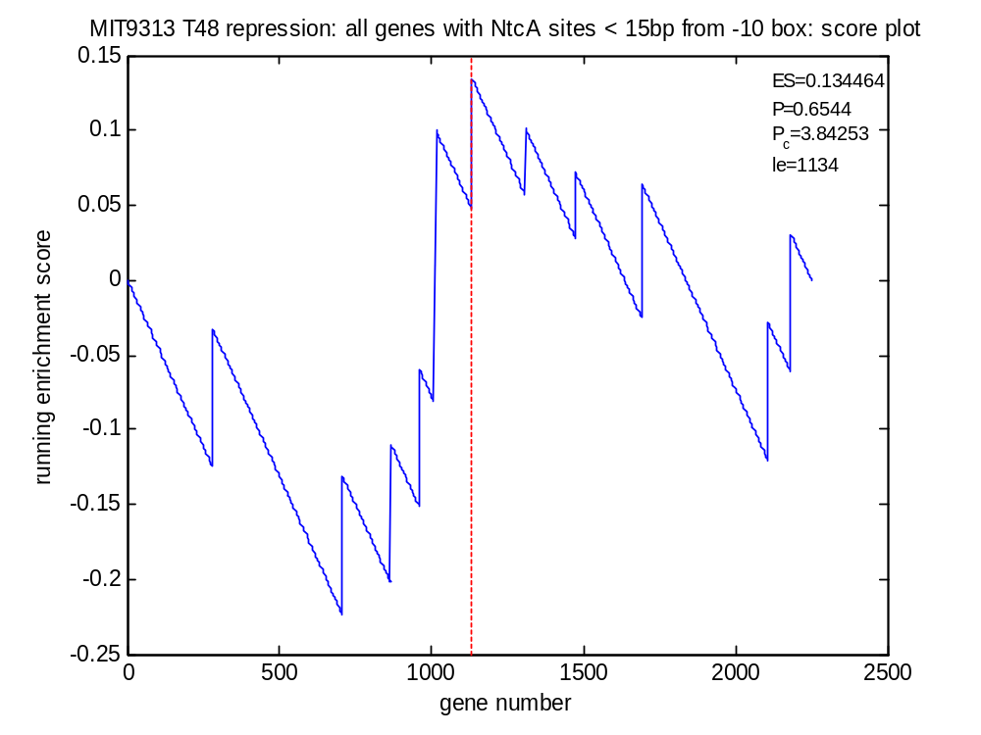
X
RNAP
gene
-10 occluded
Time = 48h
NtcA
-10 box

Slide 26
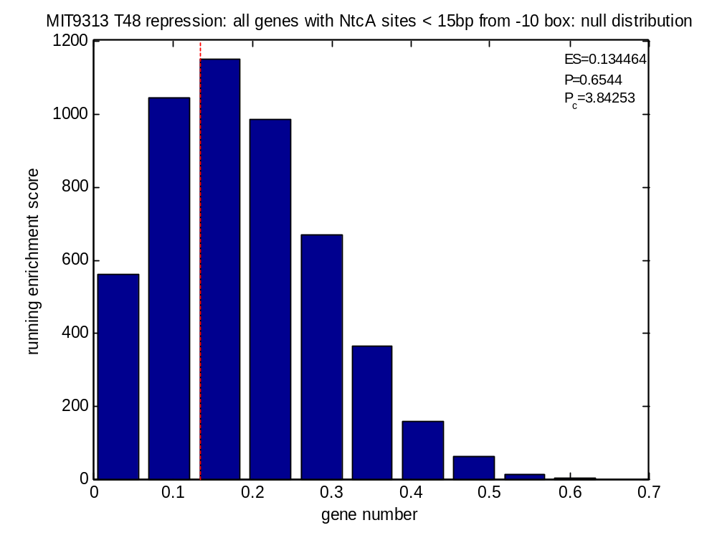
X
RNAP
gene
-10 occluded
Time = 48h
NtcA
-10 box

